Slide 1
Pre-Calc & Trig
Day 53

Slide 2
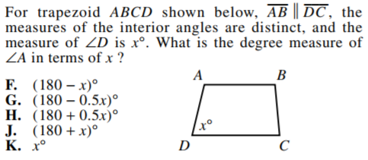
Bell Work

Slide 3
Things to Study for the Test
Level 2
Use SOH-CAH-TOA Use Calculator to Estimate Trig Functions Solve the Triangle
Law of Sine Law of Cosine
Find the Area of Triangles
Level 3
Solve the Triangle
Apply Law of Sine & Cosine
Find the Area
Level 4
Applications (like story problems in notes/ homework)

Slide 4
For Next Time
Law of Sines
Pg 434 #1, 4, 5, 7, 9, 25, 27, 39, 40, 45, 46, 49
Law of Cosines
Pg 441 #5, 7, 9, 13, 27, 29, 33, 43, 53

Slide 5
Unit 7 Quiz 1

Slide 6
6.1 Law of Sines
Objective: Use law of sines to solve and find the area of oblique triangles (AAS, ASA, SSA) while applying it to real life situations

Slide 7
Oblique Triangle: triangles that have no right angles
It is standard practice to put side a across from angle A, side b across from angle B, and side c across from angle C.

Slide 8
To Solve: you need to know at least one side and two other measures (either two sides, two angles, or one side and one angle):
1. Two angles & any side (AAS or ASA)
2. Two sides & an angle opposite one of them (SSA)
3. Three sides (SSS)
4. Two sides & their included angle (SAS)
Note: First two cases can be solved using Law of Sines, whereas the last two cases require the Law of Cosines (next section).

Slide 9
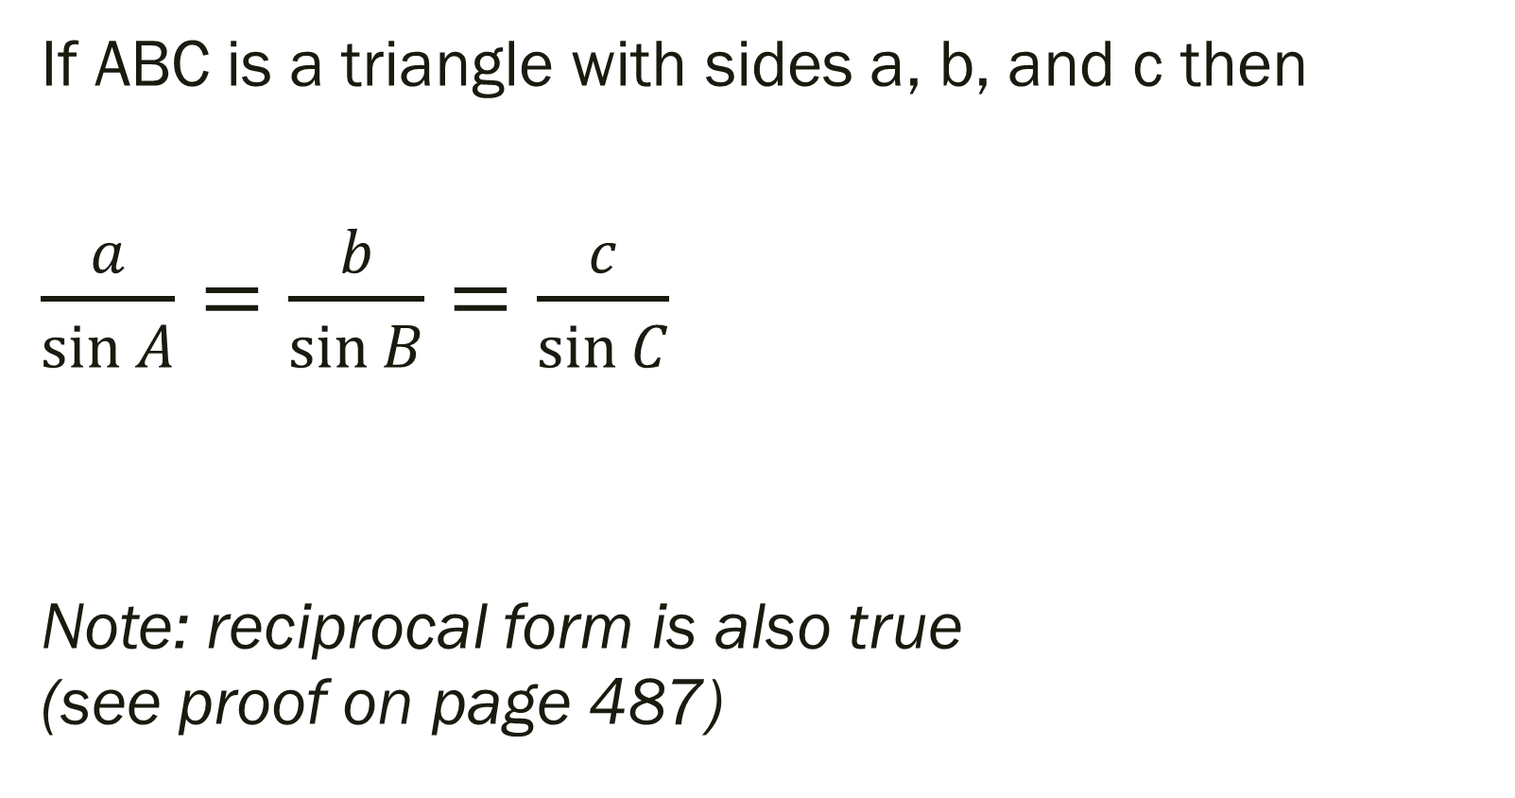
Law of Sines
If ABC is a triangle with sides a, b, and c then
$\frac{a}{\sin{A}}=\frac{b}{\sin{B}}=\frac{c}{\sin{C}}$
Note: reciprocal form is also true (see proof on page 487)

Slide 10
Example 1: Two angles and One side – AAS
For the triangle with C = 108 degrees, B = 24 degrees and b = 25. Find the remaining sides and angles.

Slide 11
Example 2: Two angles and One side – ASA
A pole tilts toward the sun at an 8 degree angle from the vertical, and it casts an 22 foot shadow. The angle of elevation from the tip of the shadow to the top of the pole is 43 degrees. How tall is the pole?

Slide 12
Ambiguous Case (SSA)
If given two sides and one angle, there are three possible situations:
1. No such triangle exists
2. One such triangle exists
3. Two distinct triangles exist
Lets go to page 430 so you can see what we’re talking about

Slide 13
Example 3: Single Solution – SSA
For a triangle, a = 20 inches, b = 10 inches, and A = 38 degrees. Find the remaining sides and angles.

Slide 14
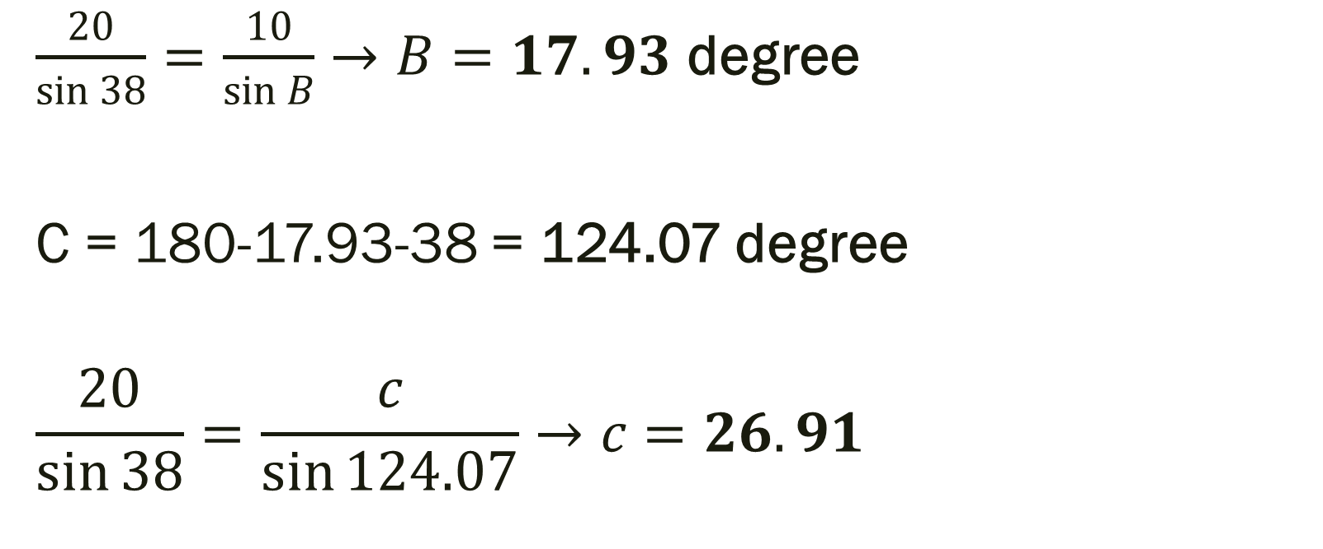
Solution: For a triangle, a = 20 inches, b = 10 inches, and A = 38 degrees. Find the remaining sides and angles.
$\frac{20}{\sin{38}}=\frac{10}{\sin{B}}→B=17.93$ degree
C = 180-17.93-38 = 124.07 degree
$$\frac{20}{\sin{38}}=\frac{c}{\sin{124.07}}→c=26.91$$

Slide 15
Example 4: Two Solution – SSA
Find two triangles for which a = 12, b = 31 and A = 20.5 degrees

Slide 16
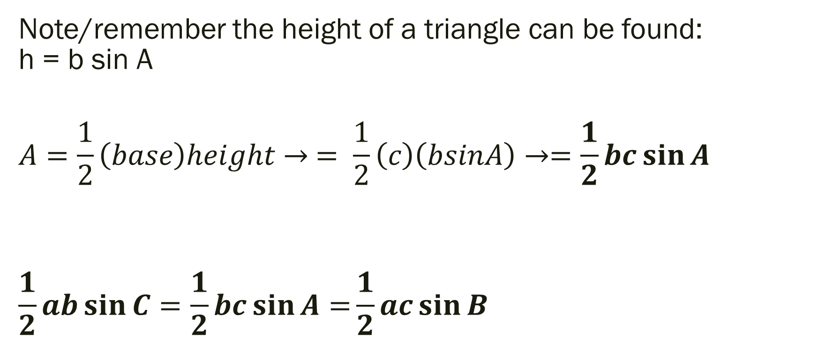
Area of an Oblique Triangle
Note/remember the height of a triangle can be found: h = b sin A
$$A=\frac{1}{2}\left(base\right)height→ = \frac{1}{2}\left(c\right)\left(bsinA\right)→=\frac{1}{2}bc\sin{A}$$
$$\frac{1}{2}ab\sin{C}=\frac{1}{2}bc\sin{A=}\frac{1}{2}ac\sin{B}$$

Slide 17
Example 5: Finding the Area of a Triangular Lot
Find the area of a triangular lot having two sides of lengths 90 and 52 and an included angle of 102 degrees.

Slide 18
6.2 Law of Cosines
Objective: Use law of cosines to solve (using SSS, SAS, SSA) and find area (Heron’s Area Formula) of oblique triangles while applying it to real life situations
Why can’t you use Law of Sines in these cases?!

Slide 19
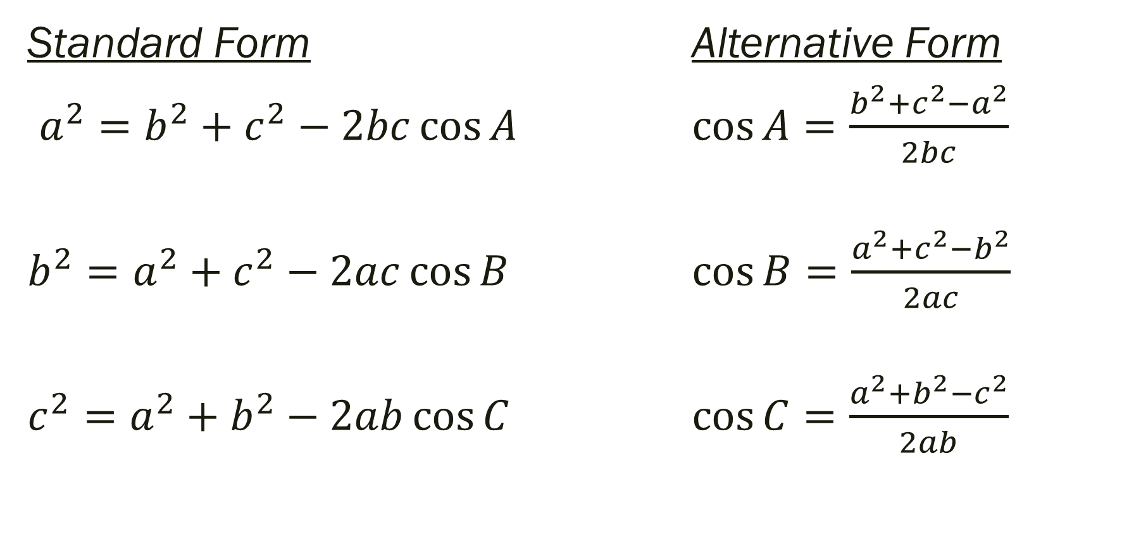
Law of Cosines (proof on page 488)
Standard Form Alternative Form
$a^{2}=b^{2}+c^{2}−2bc\cos{A}$ $\cos{A=\frac{b^{2}+c^{2}−a^{2}}{2bc}}$
$b^{2}=a^{2}+c^{2}−2ac\cos{B}$ $\cos{B=\frac{a^{2}+c^{2}−b^{2}}{2ac}}$
$c^{2}=a^{2}+b^{2}−2ab\cos{C}$ $\cos{C=\frac{a^{2}+b^{2}−c^{2}}{2ab}}$

Slide 20
Example 1: Three sides of a triangle – SSS
For the triangle with a = 8 feet, b = 19 feet and c = 14 feet. Find the remaining sides and angles.
[Good idea to find angle opposite largest side 1st
If biggest angle is obtuse, others acute… if acute all acute]

Slide 21
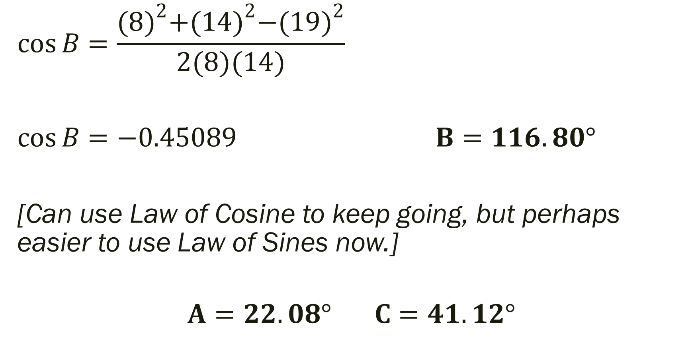
Solution:
$$\cos{B=\frac{{(8)}^{2}+{(14)}^{2}−{(19)}^{2}}{2(8)(14)}}$$
$\cos{B=−0.45089}$ $B{=116.80°}$
[Can use Law of Cosine to keep going, but perhaps easier to use Law of Sines now.]
$$A{=22.08° C{=41.12°}}$$

Slide 22

Example 2: Two Sides and the Included Angle – SAS
For the triangle with b = 9 feet, c = 12 feet and $A={25°}$. Find the remaining sides and angles.

Slide 23
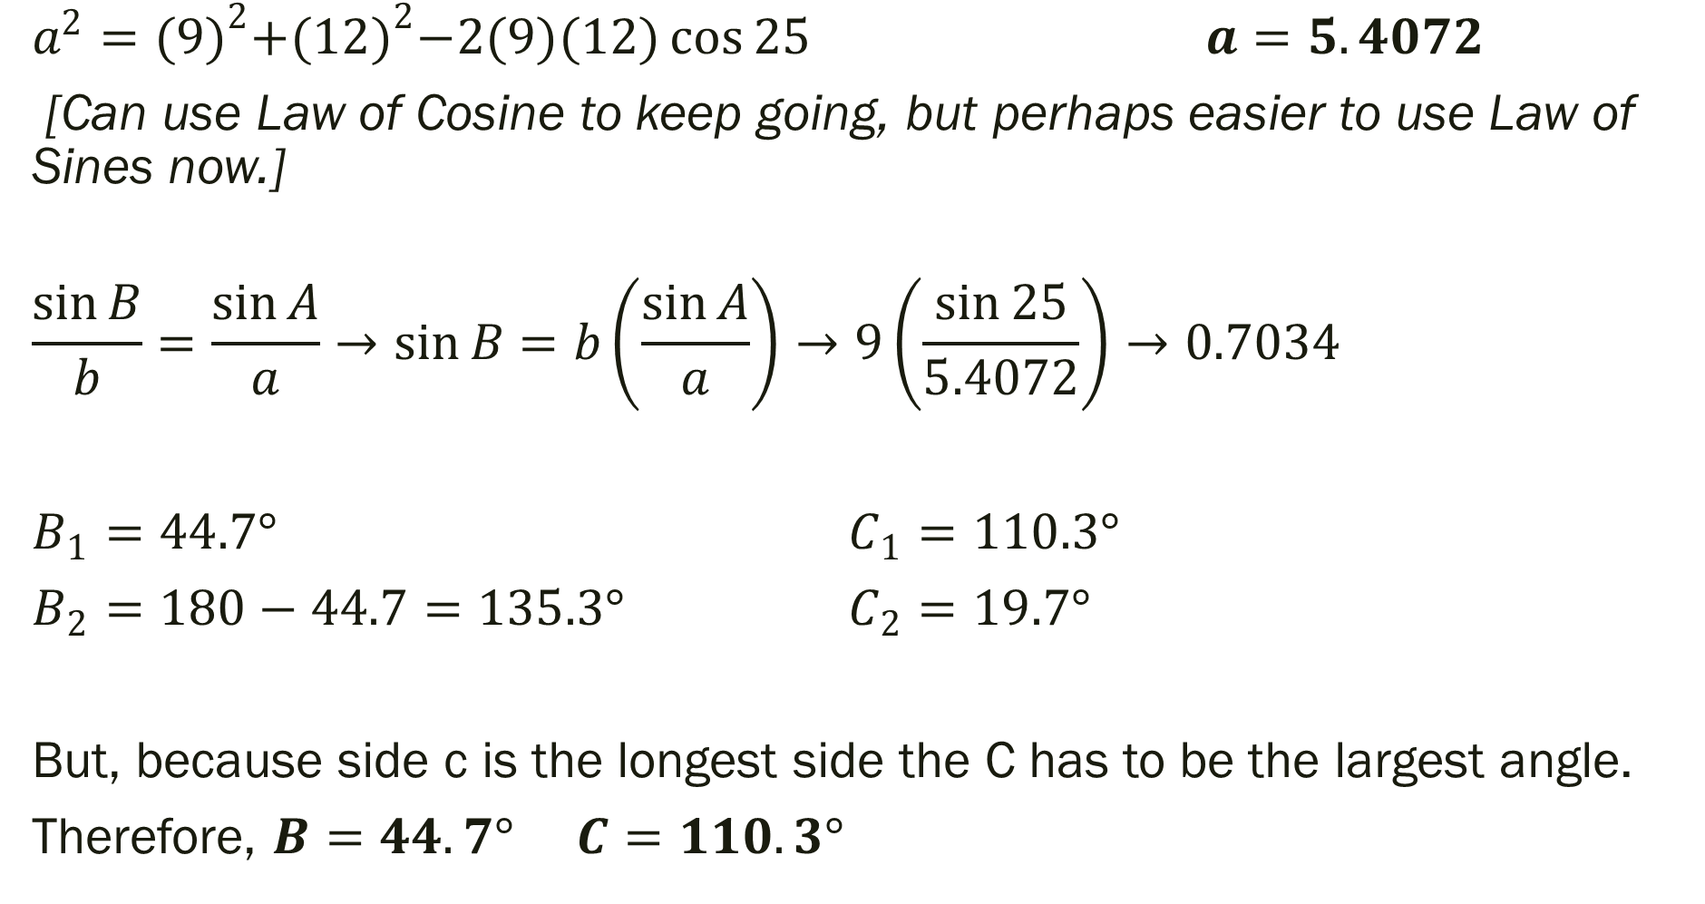
Solution:
$a^{2}={(9)}^{2}+{(12)}^{2}−2(9)(12)\cos{25}$ $a=5.4072$
[Can use Law of Cosine to keep going, but perhaps easier to use Law of Sines now.]
$$\frac{\sin{B}}{b}=\frac{\sin{A}}{a}→\sin{B}=b\left(\frac{\sin{A}}{a}\right)→9\left(\frac{\sin{25}}{5.4072}\right)→0.7034$$
$B_{1}{=44.7°}$ $C_{1}{=110.3°}$
$B_{2}{=180−44.7=135.3°}$ $C_{2}{=19.7°}$
But, because side c is the longest side the C has to be the largest angle.
Therefore, $B{=44.7°}$ $C{=110.3°}$

Slide 24
Example 3: Application of Law of Cosines
The pitcher’s mound in softball field is 43 feet from home plate and the distance from home plate and the distance between the bases is 60 feet. (Note pitcher’s mound is not halfway between home and 2nd base). How far is the pitcher’s mound from first base?

Slide 25
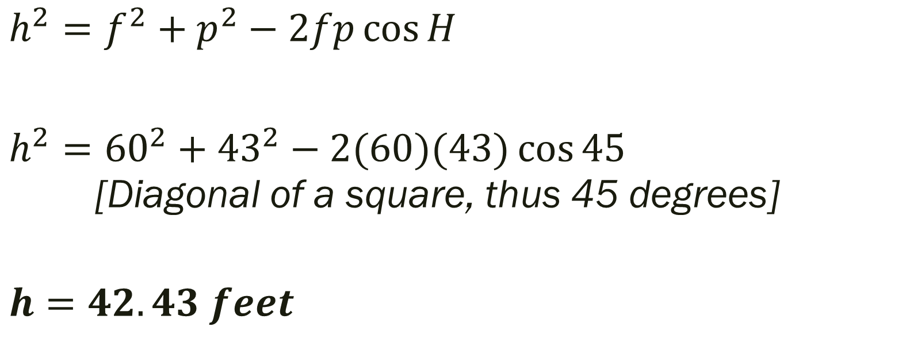
Solution:
$h^{2}=f^{2}+p^{2}−2fp\cos{H}$
$h^{2}={60}^{2}+{43}^{2}−2(60)(43)\cos{45}$ [Diagonal of a square, thus 45 degrees]
$$h=42.43 feet$$

Slide 26
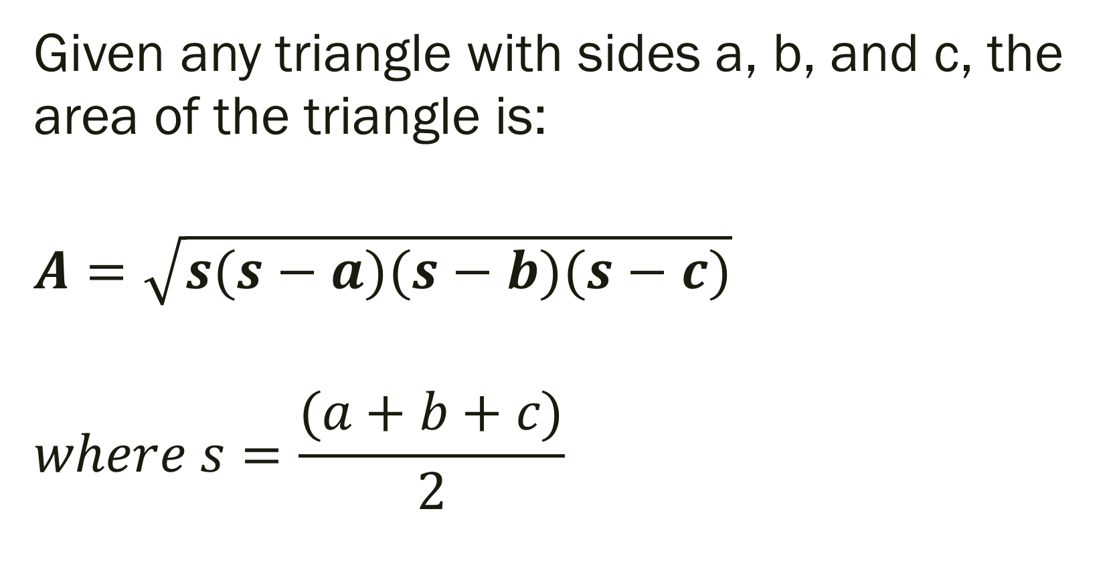
Heron’s Area Formula
Given any triangle with sides a, b, and c, the area of the triangle is:
$$A=\sqrt{s(s−a)(s−b)(s−c)}$$
$$where s=\frac{(a+b+c)}{2}$$

Slide 27
Example 4: Using Heron’s Formula
Find the area of a triangle with a = 43, b = 53, and c = 72

Slide 28
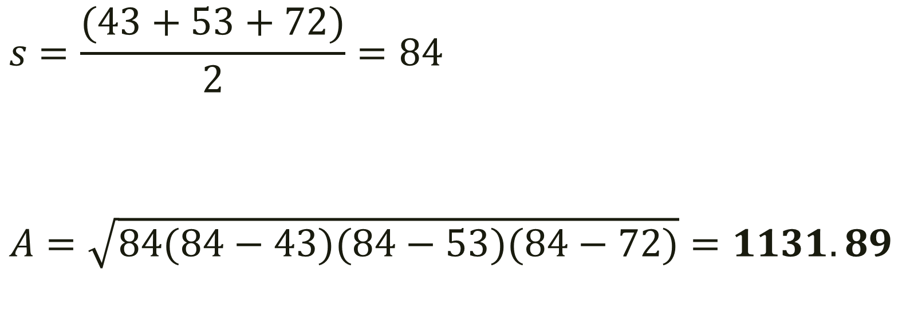
Solution:
$$s=\frac{(43+53+72)}{2}=84$$
$$A=\sqrt{84(84−43)(84−53)(84−72)}=1131.89$$

